Slide 1
Time Series Data with Recurrent Neural Networks in deep machine learning to predict patient mortality
Yanyan Deng

Slide 2
Introduction
DML help people solve challenging problems using AI and deep learning.
Developers, data scientists and engineers
Self-driving cars, healthcare and robotics
Training, optimizing, and deploying deep neural networks

Slide 3
Abstract
Build a deep neural network that can predict future outcomes based on time series
Explore and visualize a time series dataset: our real-life use case is electronic health records (EHRs) collected during hospital visits
Prepare the data for modeling
Create the neural network architecture using Keras and train it to predict mortality risk for the patients during treatment
Compare the quality of this neural network model to that of existing industry models

Slide 4
Preprocess
RNN = Recurrent Neural Network
Similar to a traditional feed-forward network
RNNs include previous output state
Limited to looking back only a few steps due to vanishing gradient
Errors are backpropagated through time
Inputs from previous time steps get exponentially down-weighted and are eventually driven to zero

Slide 5
Preprocess
LSTM = Long Short-Term Memory
Variant of RNN
No vanishing gradient problem
LSTMs can learn “very deep” tasks that require memories of events that happened or millions of discrete time steps ago
In our network, the sequence of measurements recorded from an encounter will be used as input to the network, and a probability of survival prediction will be generated.
Enables real-time monitoring of the patient’s probability of survival and insight into the patient’s trajectory

Slide 6
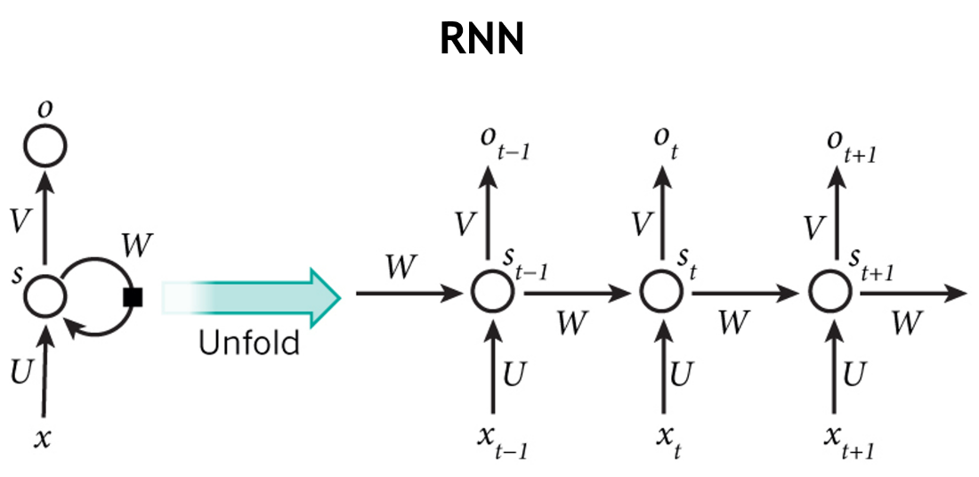
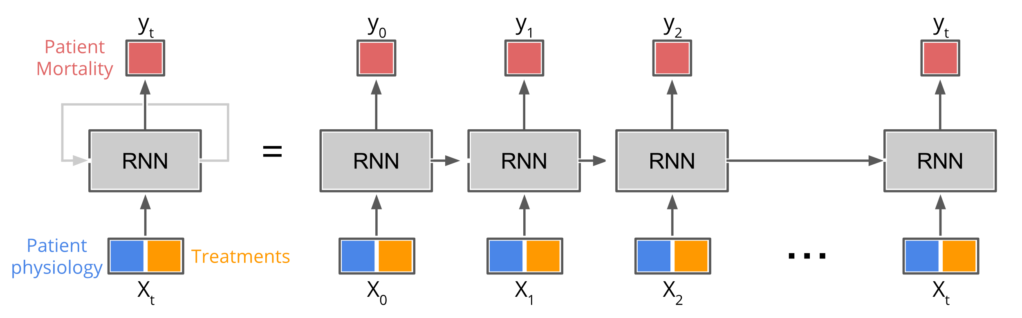
Preprocess

Slide 7
Preprocess
Keras
Modular neural network written in Python
Now imports as part of TensorFlow
Keras API allows for easy and fast prototyping
Runs on GPUs and CPUs
Compatible with Python 2.7 – 3.6

Slide 8
Preprocess
Pandas / numpy / matplotlib
Used in academia and commercial domains
Open-source, BSD-licensed project
Fast and efficient DataFrame object for data manipulation with integrated indexing
Support for large, N-dimensional arrays and matrices
Collection of high-level mathematical functions

Slide 9
Data
Data provided by PICU at Children’s Hospital Los Angeles
5,000 unique patient encounters in the training set
Each encounter includes multiple observations during the hospital stay
Each observation includes values in some of the 265 measurement variable categories
Dependent variable:
Alive – 1
Not alive – 0
Normalize data
Fill data gaps
Pad and truncate the data sequences

Slide 10
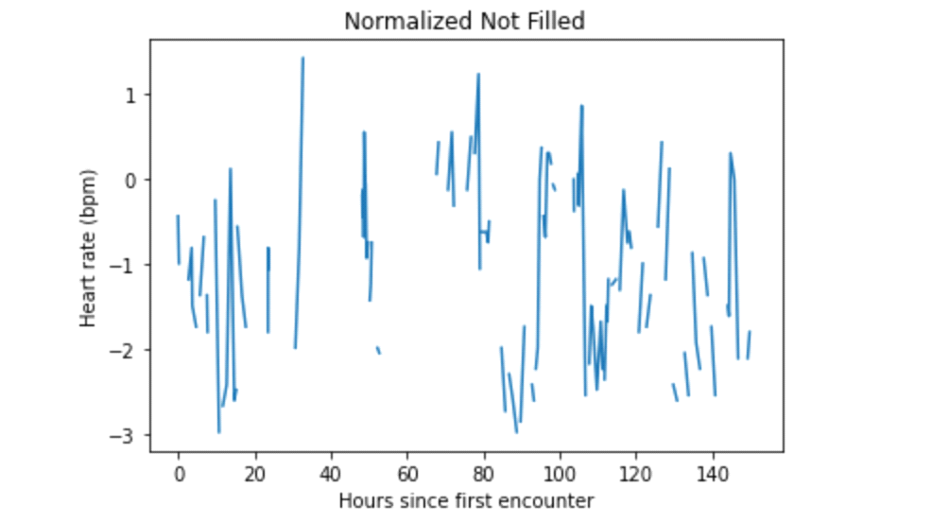
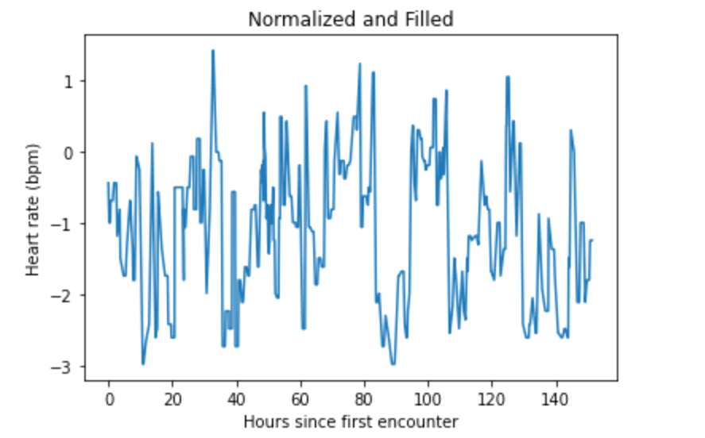
Discussion

Slide 11
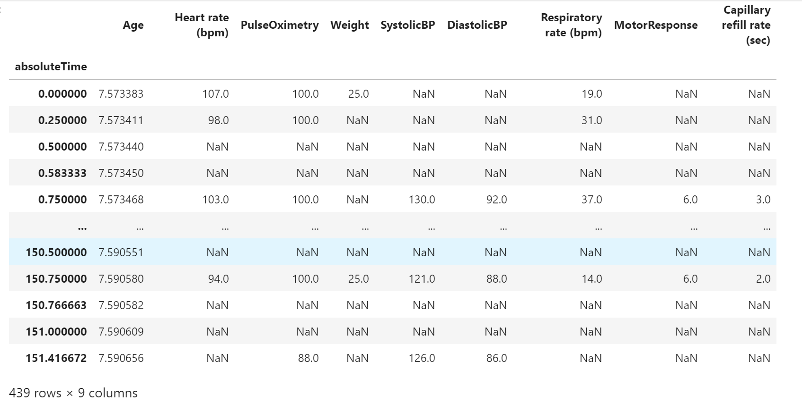
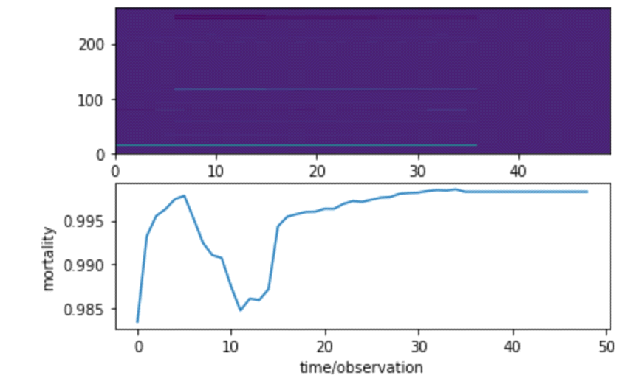
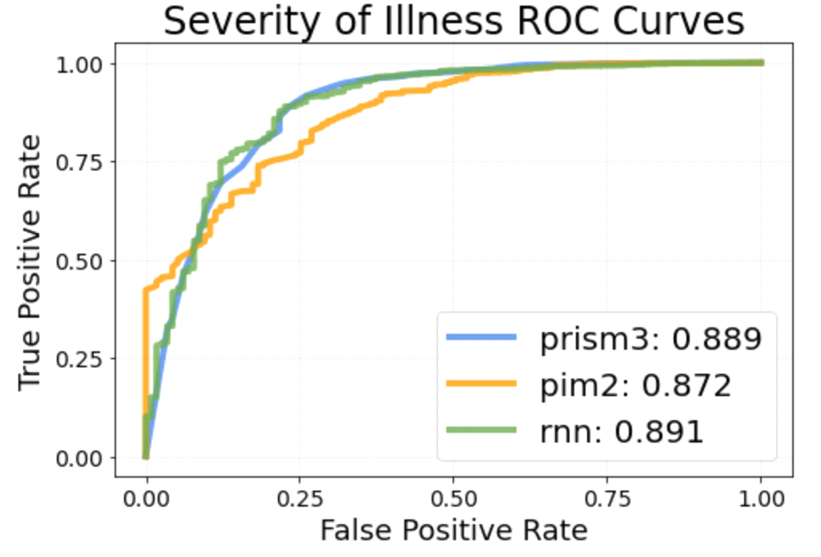
Discussion

Slide 12
Conclusion
The mortality rate of patients is the lowest between 10 and 20 hours, and the increase in mortality tends to be stable after more than 20 hours or even after 50 hours.
RNNs provide a method to quickly extract clinically significant information and insights from available EHR data.
The examples below display the performance of a fully trained RNN on a larger dataset. They also show the performance of PIM2 and PRISM3, two standard scoring systems, as well as the performance of a logistic regression model and a multi-layer perceptron (MLP).

